Slide 1
Presentation on DATABASE AND CLOUD SECURITY

Slide 2
Presented to Falguni Roy Assistant Professor IIT,NSTU
Presented By
Md Raj Biswas
ASH 1925001M
Nayeem Khan
ASH1925027M

Slide 3
Chapter Content
The Need For Database Security Add your second bullet point here
Database Management Systems
Relational Databases
SQL Injection Attacks
Database Access Control
Inference
Database Encryption
Cloud Computing
Cloud Security Risks And Countermeasures
Data Protection In The Cloud
Cloud Security As A Service

Slide 4



The Need For Database Security
In today’s world, we need everything secured whether it is your mobile phone , computer , vehicle or almost anything

Slide 5



What is database security?
Database: It is a collection of information stored in a computer
Security : It is being free from danger
Database Security : It is the mechanisms that protect the database against intentional or accidental threats. Database Security is defined as the process by which “Confidentiality, Integrity and Availability” of the database can be protected

Slide 6
If there is no security to database what happens??
It is important to restrict access to the database from authorized users to protect sensitive data.
Organizational databases tend to concentrate sensitive information in a single logical system. Examples include:
Corporate financial data
Confidential phone records
Customer and employee information, such as name, Social Security number, bank account information, and credit card information
Proprietary product information
Health care information and medical records

Slide 7
DATABASE MANAGEMENT SYSTEMS
Accompanying the database is a database management system (DBMS), which is a suite of programs for constructing and maintaining the database and for offering ad hoc query facilities to multiple users and applications. A query language provides a uniform interface to the database for users and applications.
DDL: Database designers and administrators make use of a data definition language (DDL) to define the database logical structure and procedural properties, which are represented by a set of database description tables.
DML: A data manipulation language (DML) provides a powerful set of tools for application developers.

Slide 8
RELATIONAL DATABASES
The basic building block of a relational database is a table of data, consisting of rows and columns
Elements of a Relational Database System :
1.In relational database parlance, the basic building block is a relation,
2. Tuples
3. Attributes
Basic Terminology for Relational Databases
Formal Name | Common Name | Also Known As
Relation | Table | File
Tuple | Row | Record
Attribute | Column | Field

Slide 9
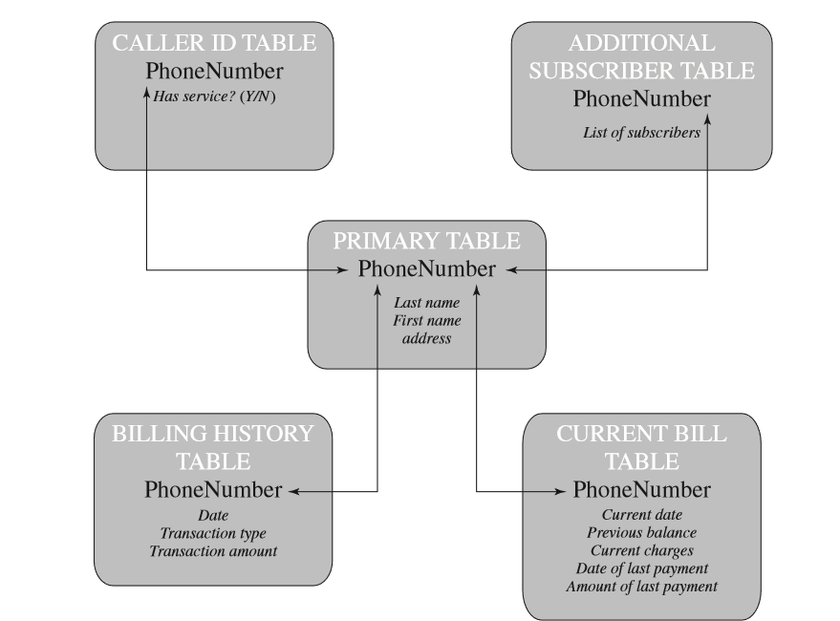

Slide 10
Structured Query Language (SQL)
CREATE TABLE department (
Did INTEGER PRIMARY KEY,
Dname CHAR (30),
Dacctno CHAR (6) )
CREATE TABLE employee (
Ename CHAR (30),
Did INTEGER,
SalaryCode INTEGER,
Eid INTEGER PRIMARY KEY,
Ephone CHAR (10),
FOREIGN KEY (Did) REFERENCES department (Did) )

Slide 11
The basic command for retrieving information is the SELECT statement.
SELECT Ename, Eid, Ephone
FROM Employee
WHERE Did = 15

Slide 12
SQL INJECTION ATTACK
The SQL injection (SQLi) attack is one of the most prevalent and dangerous network-based security threats
1.The July 2013 Imperva Web Application Attack Report [IMPE13]
Web site that received 94,057 SQL injection attack requests in one day.
Software Security Report [VERA13]
SQLi attacks is around 32%

Slide 13
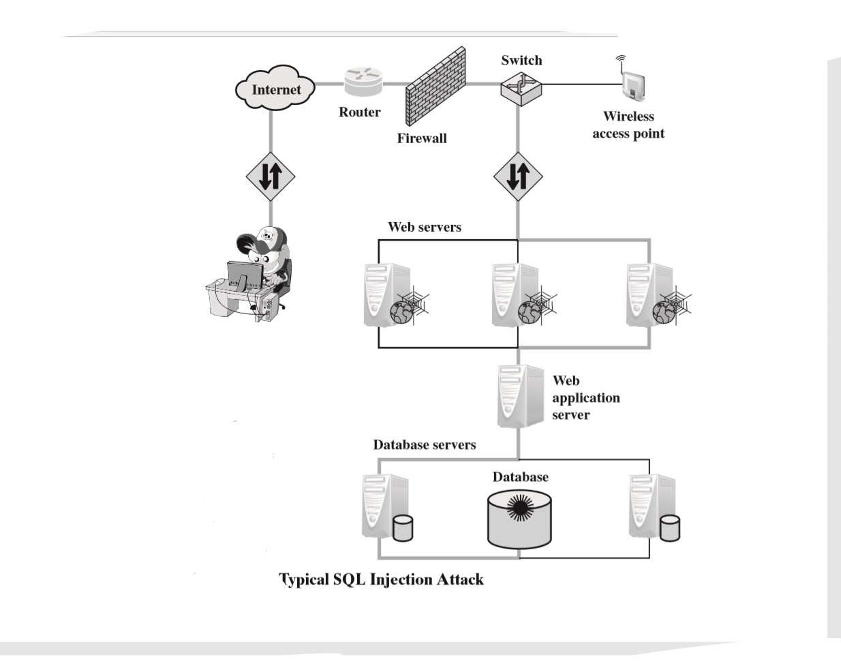

Slide 14
1. Hacker finds a vulnerability in a custom Web application and injects an SQL command to a database by sending the command to the Web server. The command is injected into traffic that will be accepted by the firewall.
2. The Web server receives the malicious code and sends it to the Web application server.
3. The Web application server receives the malicious code from the Web server and sends it to the database server.
4. The database server executes the malicious code on the database. The database returns data from credit cards table.
5. The Web application server dynamically generates a page with data including credit card details from the database.
6. The Web server sends the credit card details to the hacker.

Slide 15
The Injection Technique
SELECT * FROM OrdersTable WHERE ShipCity = ‘Redmond’
Boston’; DROP table OrdersTable- or like 4--1=1
This results in the following SQL query:
SELECT * FROM OrdersTable WHERE ShipCity = ‘Redmond’; DROP table OrdersTable-

Slide 16
SQLi Attack Avenues and Types
1.User input:
2.Server variables:
3.Second-order injection:
4.Cookies:
5.Physical user input:

Slide 17
Attack types can be grouped into three main categories:
Inband 2. inferential, 3.And out-of-band
1.Tautology
2.End-of-line comment
3.Piggybacked queries
1. Illegal/logically incorrect queries
2Blind SQL injection
In an out-of-band attack, data are retrieved using a different channel (e.g., an email with the results of the query is generated and sent to the tester). This can be used when there are limitations on information retrieval, but outbound connectivity from the database server is lax.

Slide 18
Tautology:
$query = “SELECT info FROM user WHERE name = ’$_GET[“name”]’ AND pwd = ‘$_GET[“pwd”]’”;
Suppose the attacker submits “ ‘ OR 1=1 --” for the name field. The resulting query would look like this:
SELECT info FROM users WHERE name = ‘ ‘ OR 1=1 -- AND pwpd = ‘ ‘
End-of-line comment:
After injecting code into a particular field, legitimate code that follows are nullified through usage of end of line comments. An example would be to add ”- -” after inputs so that remaining queries are not treated as executable code, but comments.

Slide 19
Piggybacked queries:The attacker adds additional queries beyond the intended query, piggy-backing the attack on top of a legitimate request.
With an inferential attack, there is no actual transfer of data.
Illegal/logically incorrect queries: This attack lets an attacker gather important information about the type and structure of the backend database of a Web application.
Blind SQL injection: Blind SQL injection allows attackers to infer the data present in a database system even when the system is sufficiently secure to not display any erroneous information back to the attacker.

Slide 20
SQLi Countermeasures :
Many SQLi attacks succeed because developers have used insecure coding practices. Thus, defensive coding is an effective way to dramatically reduce the threat from SQLi. Examples of defensive coding include the following:
Manual defensive coding practices: A common vulnerability exploited by SQLi attacks is insufficient input validation. The straightforward solution for eliminating these vulnerabilities is to apply suitable defensive coding practices. An example is input type checking
Parameterized query insertion: This approach attempts to prevent SQLi by allowing the application developer to more accurately specify the structure of an SQL query, and pass the value parameters to it separately such that any unsanitary user input is not allowed to modify the query structure.
SQL DOM:SQL DOM is a set of classes that enables automated data type validation and escaping

Slide 21
A variety of detection methods have been developed, including the following:
Signature based: This technique attempts to match specific attack patterns. Such an approach must be constantly updated and may not work against selfmodifying attacks.
Anomaly based: This approach attempts to define normal behavior and then detect behavior patterns outside the normal range.
Code analysis: Code analysis techniques involve the use of a test suite to detect SQLi vulnerabilities. The test suite is designed to generate a wide range of SQLi attacks and assess the response of the system.

Slide 22
Finally, a number of run-time prevention techniques have been developed as SQLi countermeasures. These techniques check queries at runtime to see if they conform to a model of expected queries. Various automated tools are available for this purpose
DATABASE ACCESS CONTROL
Access control is a security technique that can be used regulate who or what can view or use the resources in a computing environment . There are two main type of access control limits access to campus ,building ,rooms and physical IT assets. Logical access limits connections to computer network , system file and data.
On the other hand there are another classification

Slide 23
Centralized administration: A small number of privileged users may grant and revoke access rights.
Ownership-based administration: The owner (creator) of a table may grant and revoke access rights to the table.
Decentralized administration: In addition to granting and revoking access rights to a table, the owner of the table may grant and revoke authorization rights to other users, allowing them to grant and revoke access rights to the table.

Slide 24
SQL-Based Access Definition
SQL provides two commands for managing access rights, GRANT and REVOKE.
GRANT :
GRANT { privileges | role }
[ON table]
TO { user | role | PUBLIC }
[IDENTIFIED BY password]
[WITH GRANT OPTION]
Example:
GRANT SELECT ON ANY TABLE TO ricflair

Slide 25
REVOKE
The REVOKE command has the following syntax:
REVOKE { privileges | role }
[ON table]
FROM { user | role | PUBLIC }
Example:
REVOKE SELECT ON ANY TABLE FROM ricflair

Slide 26
Role-Based Access Control:
Role-Based Access Control A role-based access control (RBAC) scheme is a natural fit for database access control.
In a discretionary access control environment, we can classify database users in three broad categories:
Application owner: An end user who owns database objects (tables, columns, rows) as part of an application. That is, the database objects are generated by the application or are prepared for use by the application.
End user other than application owner: An end user who operates on database objects via a particular application but does not own any of the database objects.
Administrator: User who has administrative responsibility for part or all of the database.

Slide 27
A database RBAC facility needs to provide the following capabilities:
Create and delete roles.
Define permissions for a role.
Assign and cancel assignment of users to roles.
Fixed server roles are defined at the server level and exist independently of any user database.
Fixed database roles operate at the level of an individual database.

Slide 28
INFERENCE
Inference, as it relates to database security, is the process of performing authorized queries and deducing unauthorized information from the legitimate responses received.
The inference problem arises when the combination of a number of data items is more sensitive than the individual items, or when a combination of data items can be used to infer data of a higher sensitivity
Metadata refers to knowledge about correlations or dependencies among data items that can be used to deduce information not otherwise available to a particular user

Slide 29
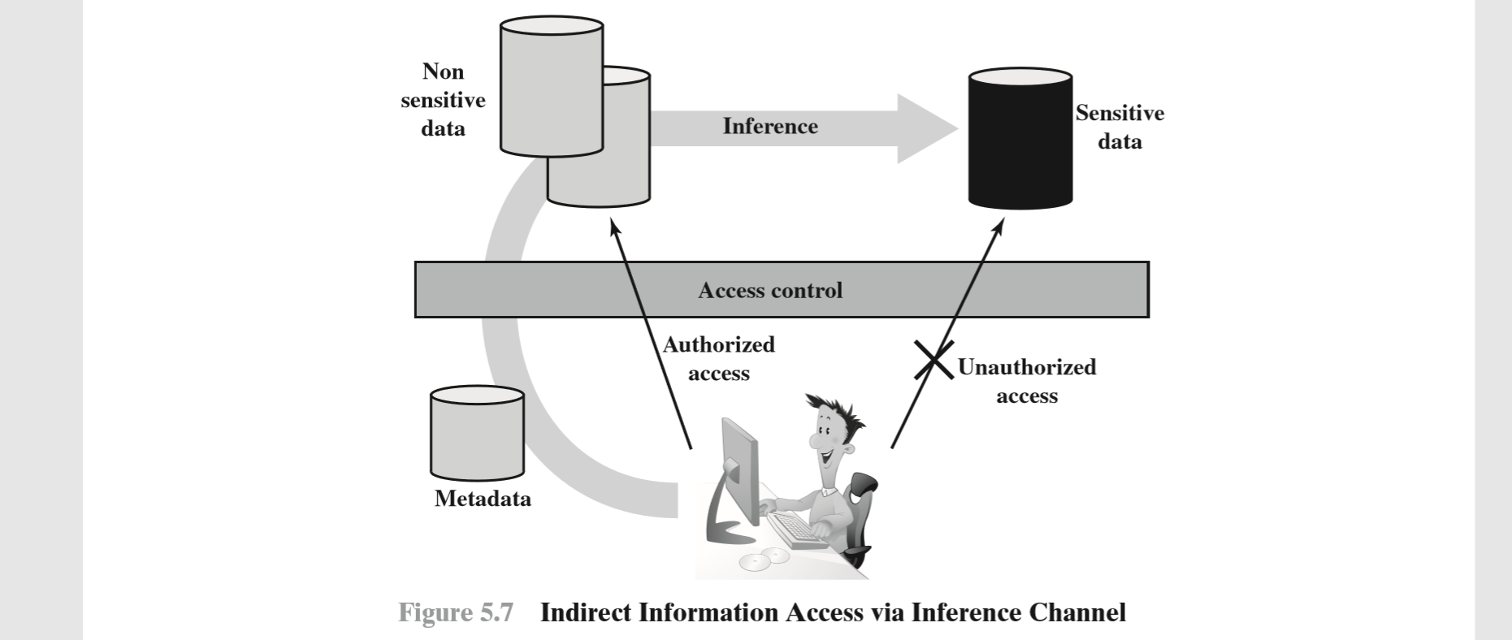
The information transfer path by which unauthorized data is obtained is referred to as an inference channel.
two inference techniques can be used to derive additional information: analyzing functional dependencies between attributes within a table or across tables, and merging views with the same constraints.

Slide 30
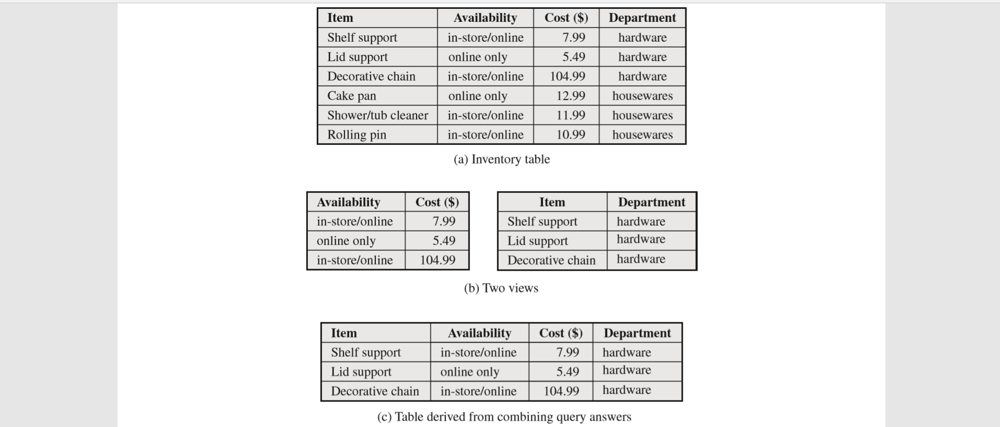

Slide 31
DATABASE ENCRYPTION
The database is typically the most valuable information resource for any organization and is therefore protected by multiple layers of security, including firewalls, authentication mechanisms, general access control systems, and database access control systems. In addition, for particularly sensitive data, database encryption is warranted and often implemented. Encryption becomes the last line of defense in database security
There are two disadvantages to database encryption
1.Key management:
2.Inflexibility: When part or all of the database is encrypted, it becomes more difficult to perform record searching.

Slide 32
Data Encryption
It is the process that uses an the algorithm to transform/control store data in database tables into cipher encrypted text . Purpose of data encryption is to protect data to malicious uses.
There are use many method to encrypt data . Some of those are…
1.Transparent/External 2.Cdumn-level
3.Symmetric 4.Asymmetric
5.Application LEvel

Slide 33
Transparent/External
All the database and backup are encrypted with a single encryption.
External security Module
Key
EmpID | Sal
#a | $q2c1
#b | $a3fn
EmpID | Sal
1 | 1000
2 | 2000
DB
Encryption
DB
Decryption
Emp table
Clear text
TDE
Cipher text
Emp table

Slide 34
Cdumn-level
Individual culumns can be encrypted with a separate key.
Symmetric
Private key is used for view or access the data.
Asymmetric
Separate key are use to encrypt and decrypt the data
Application Level
Application level use to data encryption.Here encryption happen first and then store the data

Slide 35
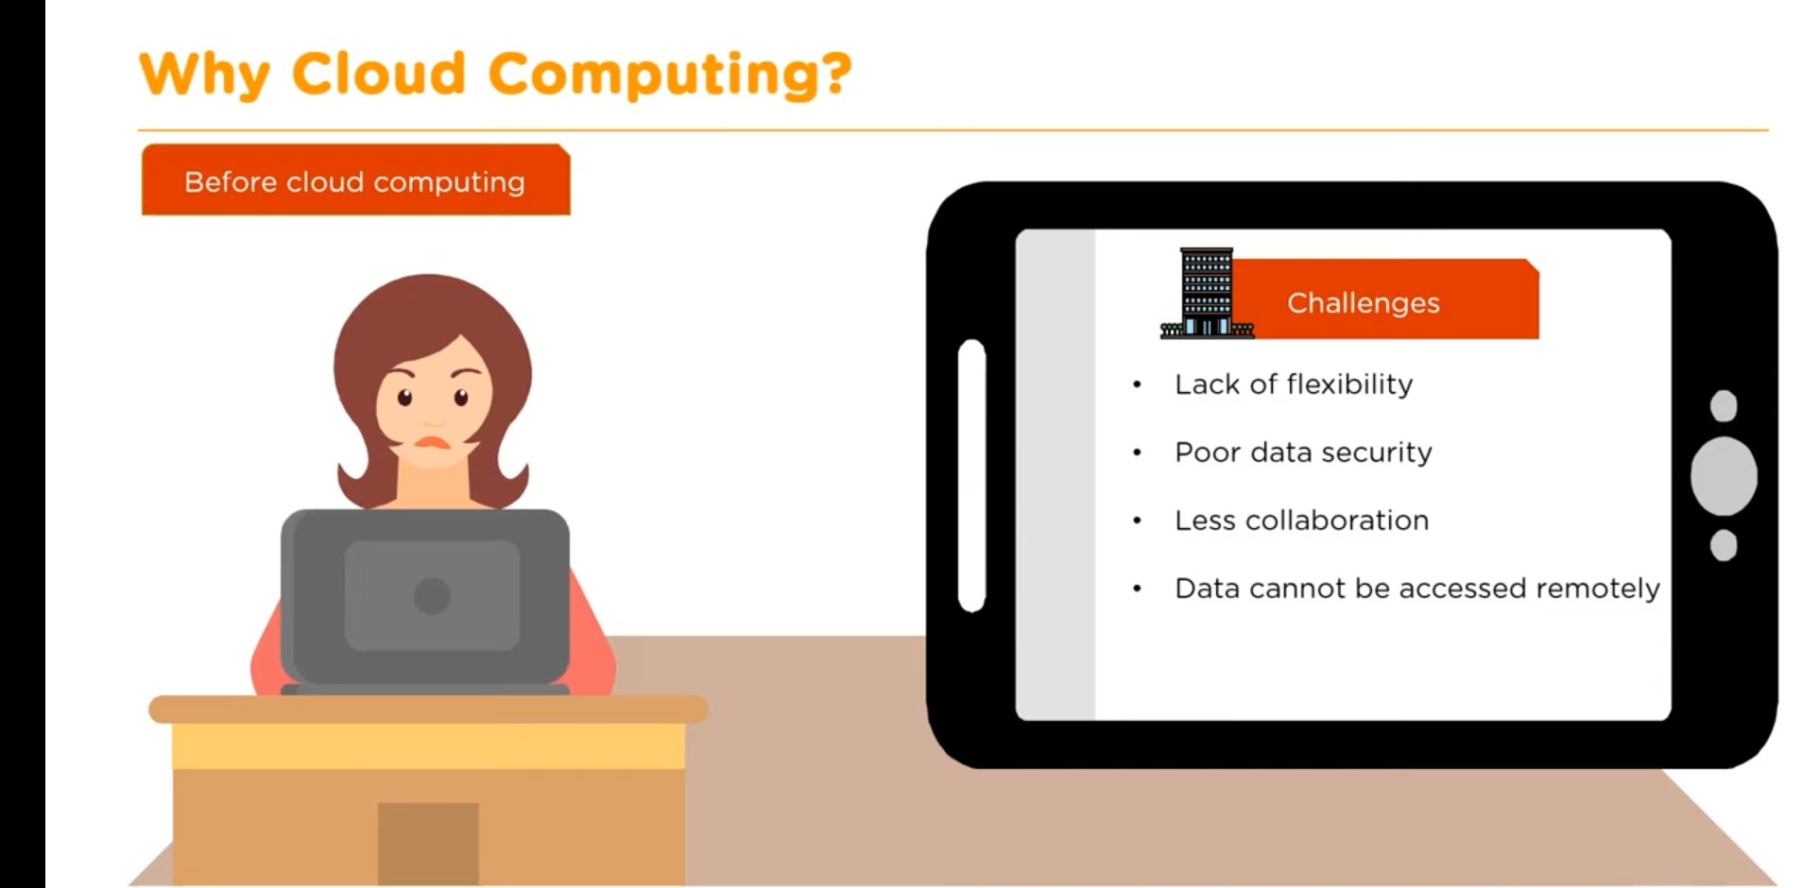
CLOUD COMPUTING

Slide 36
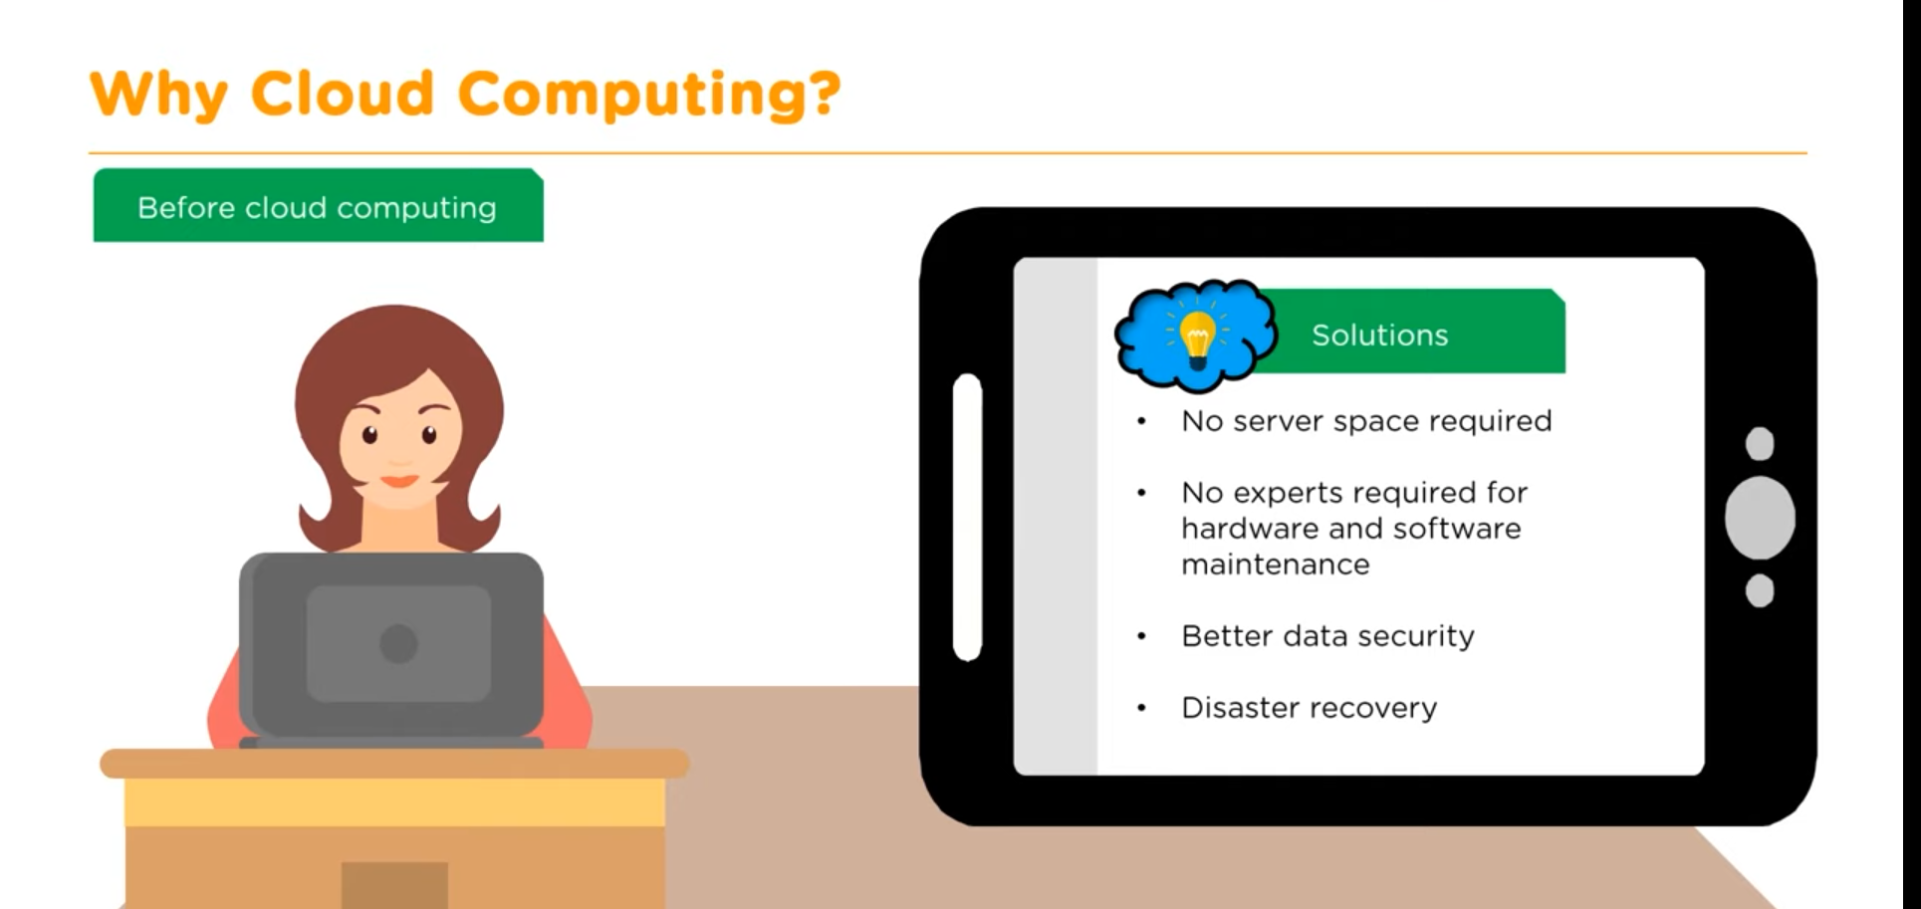

Slide 37
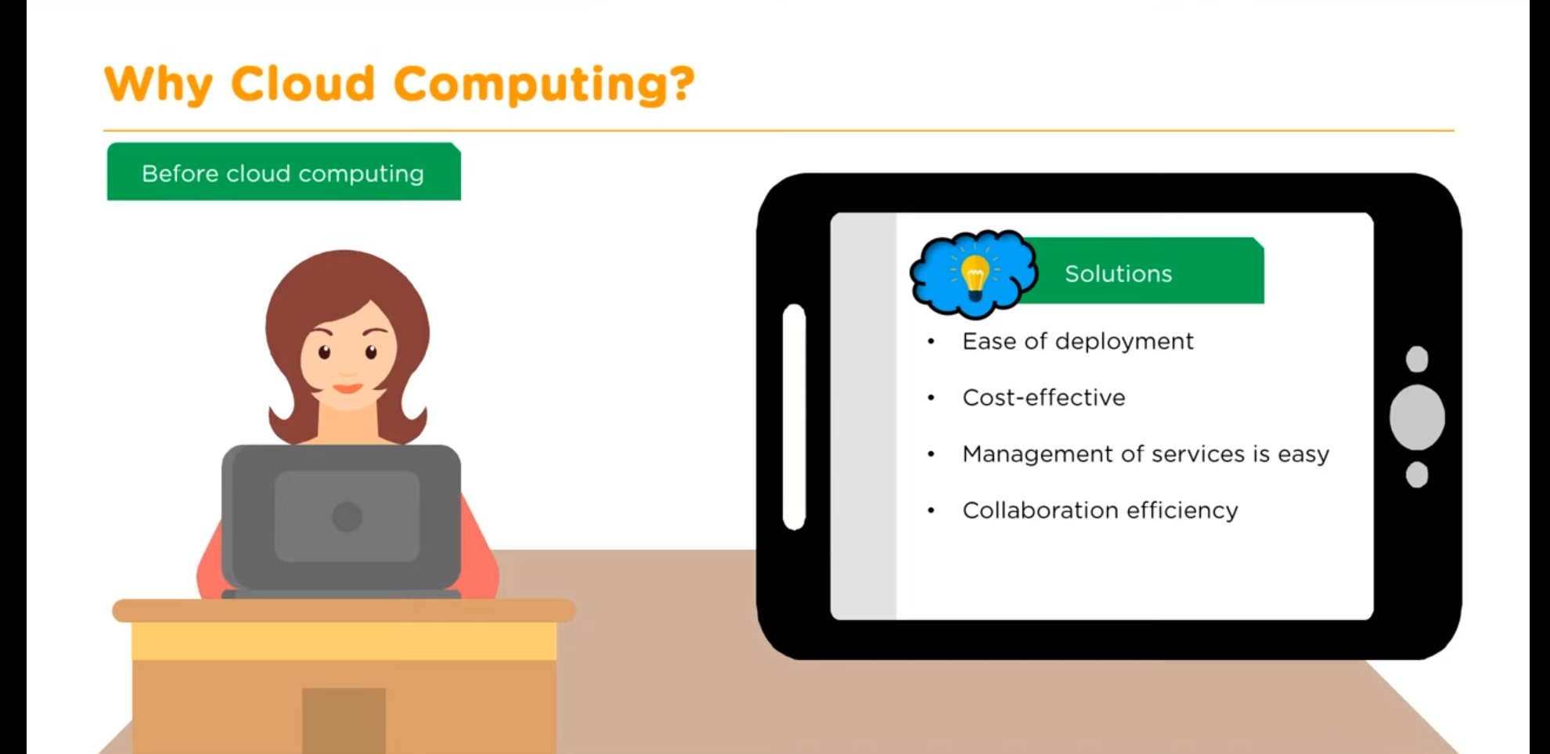

Slide 38
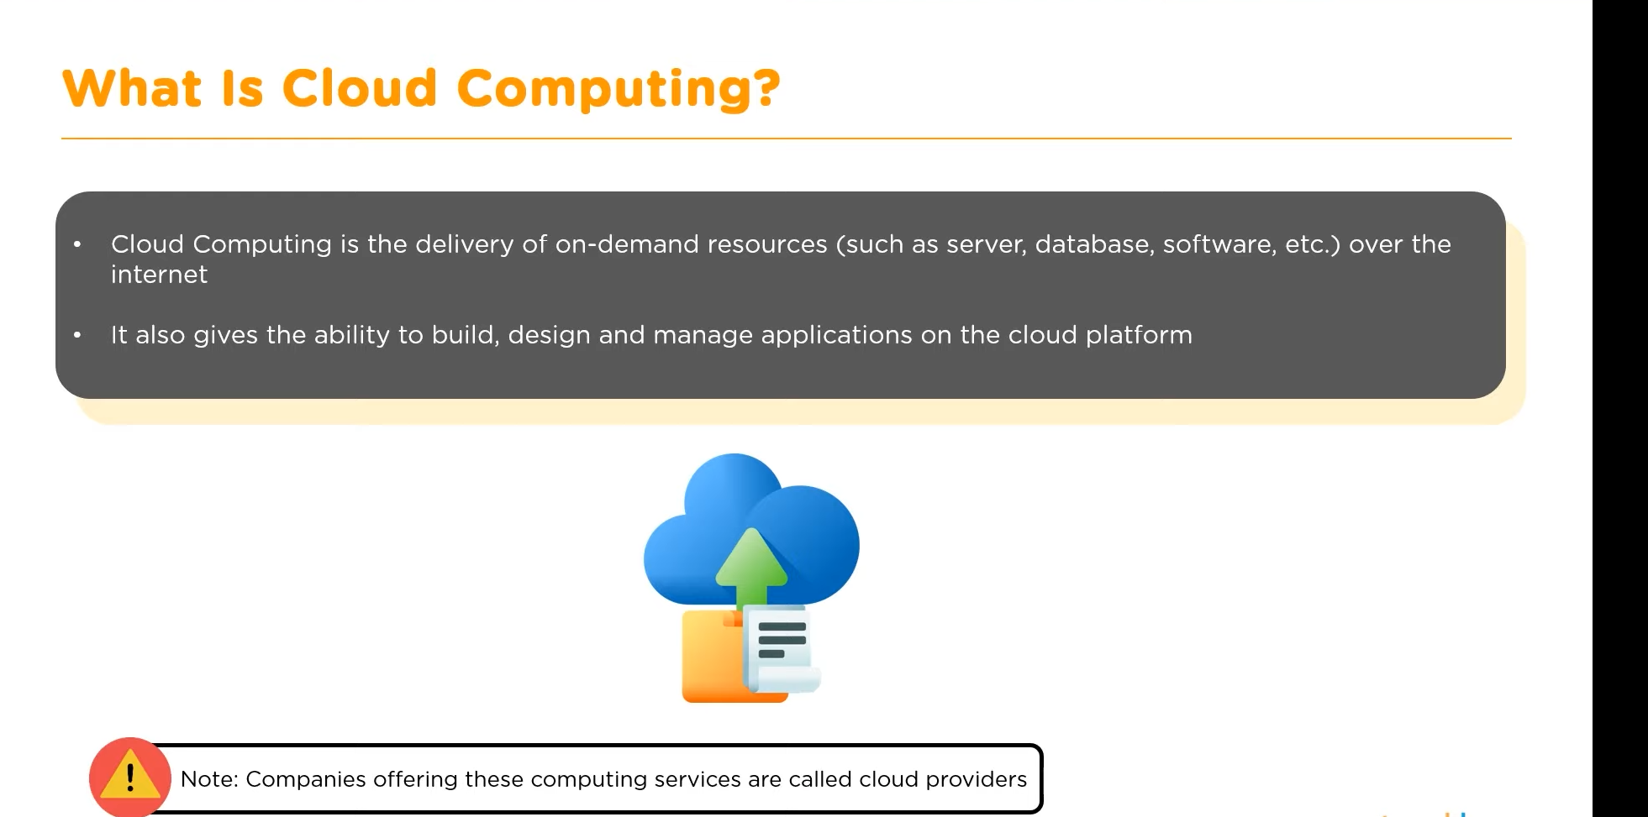

Slide 39
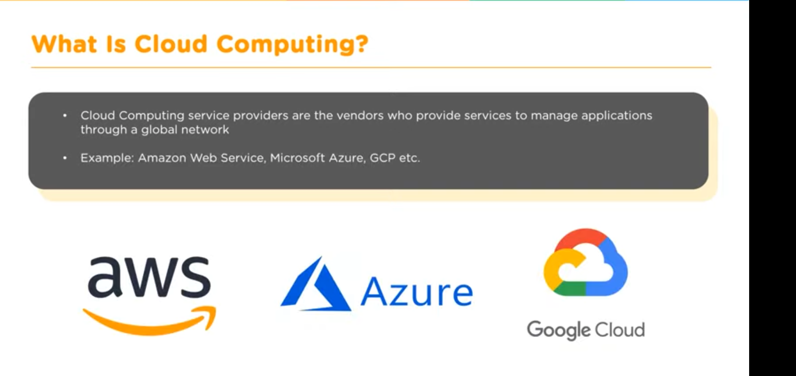

Slide 40
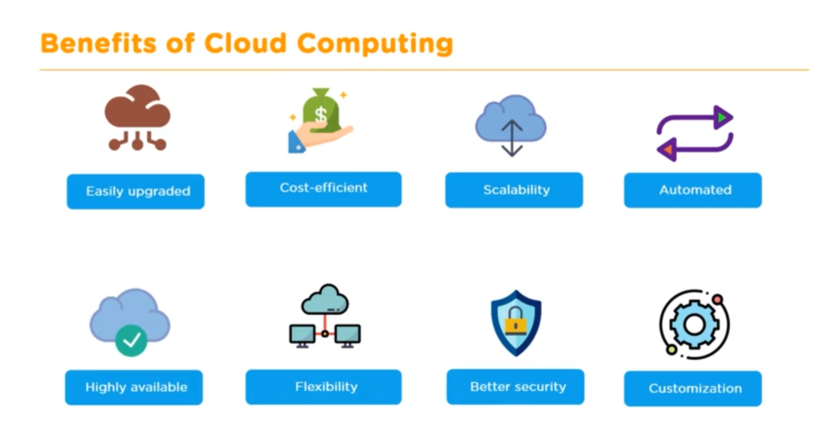

Slide 41
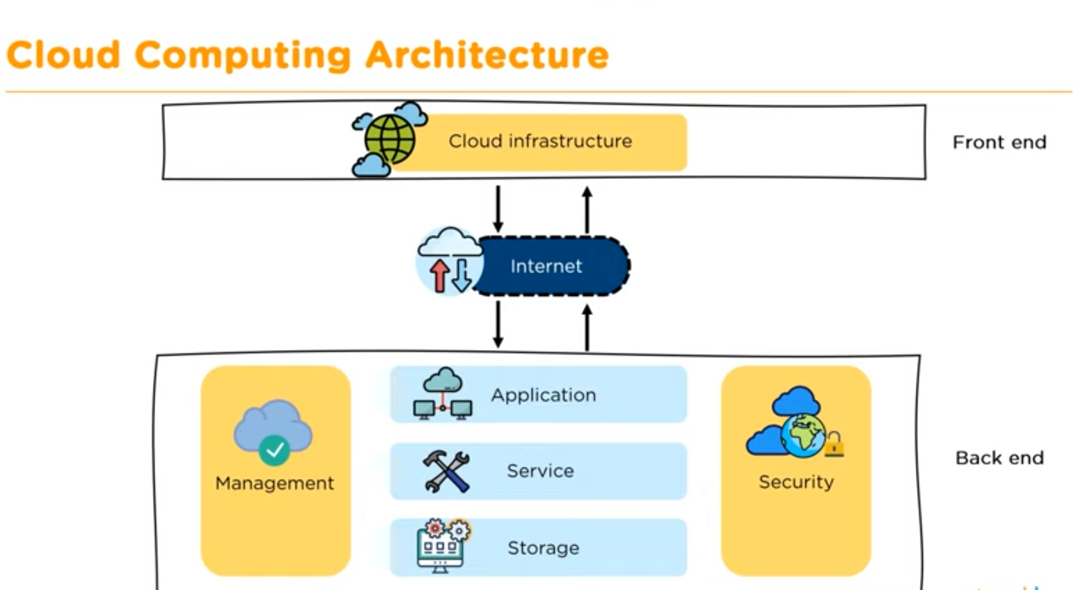

Slide 42
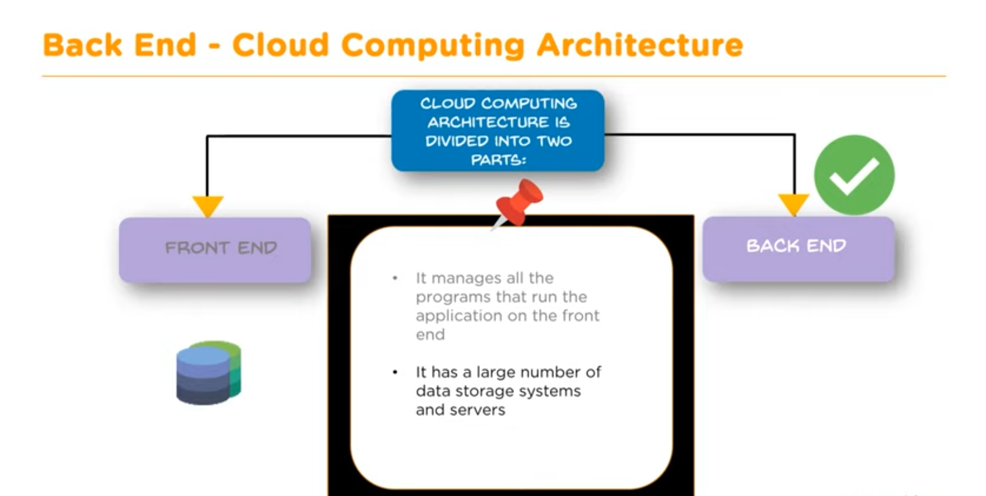

Slide 43
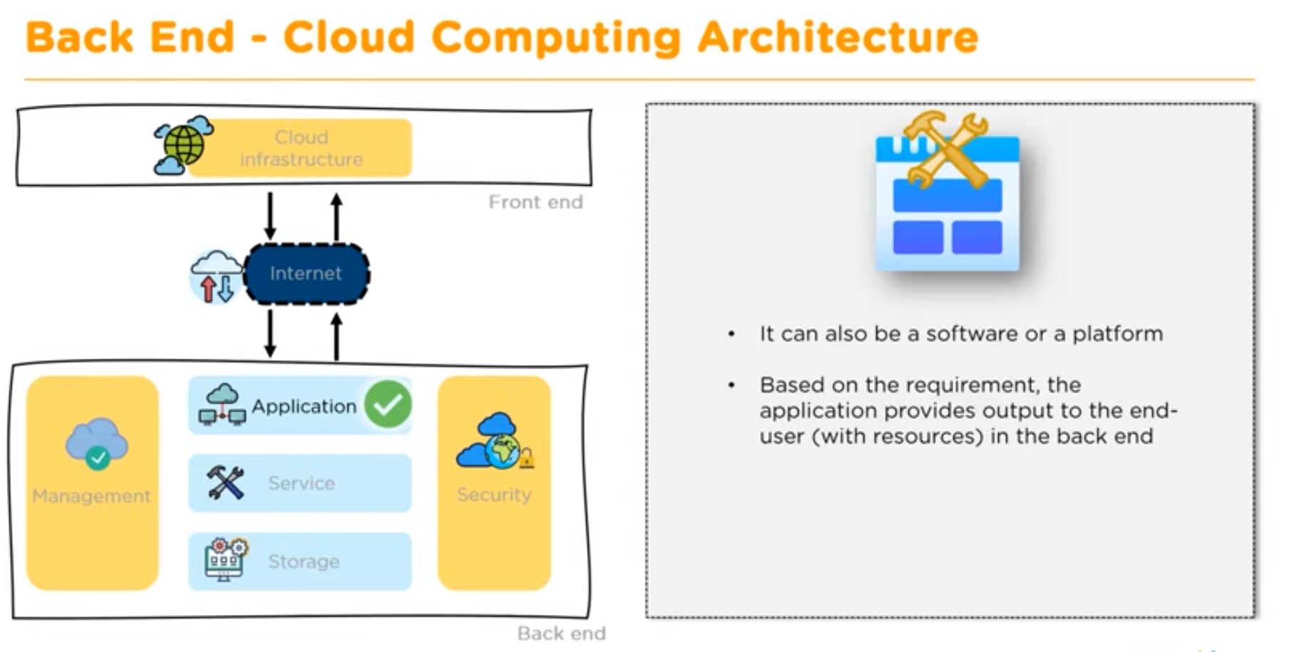

Slide 44
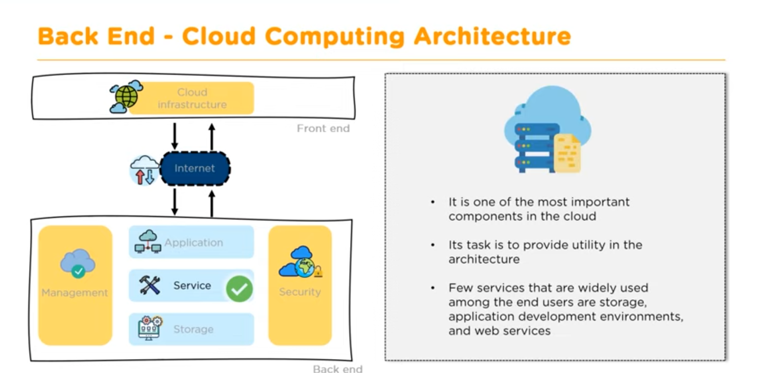

Slide 45
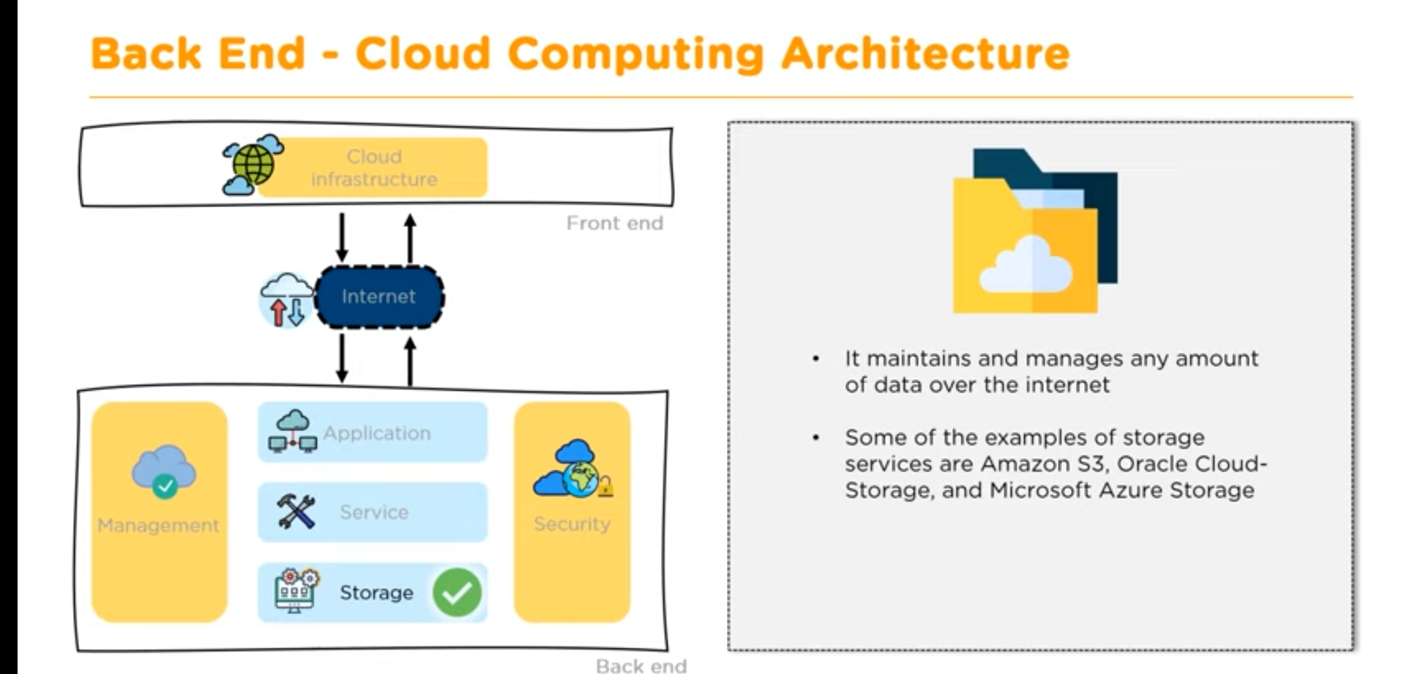

Slide 46
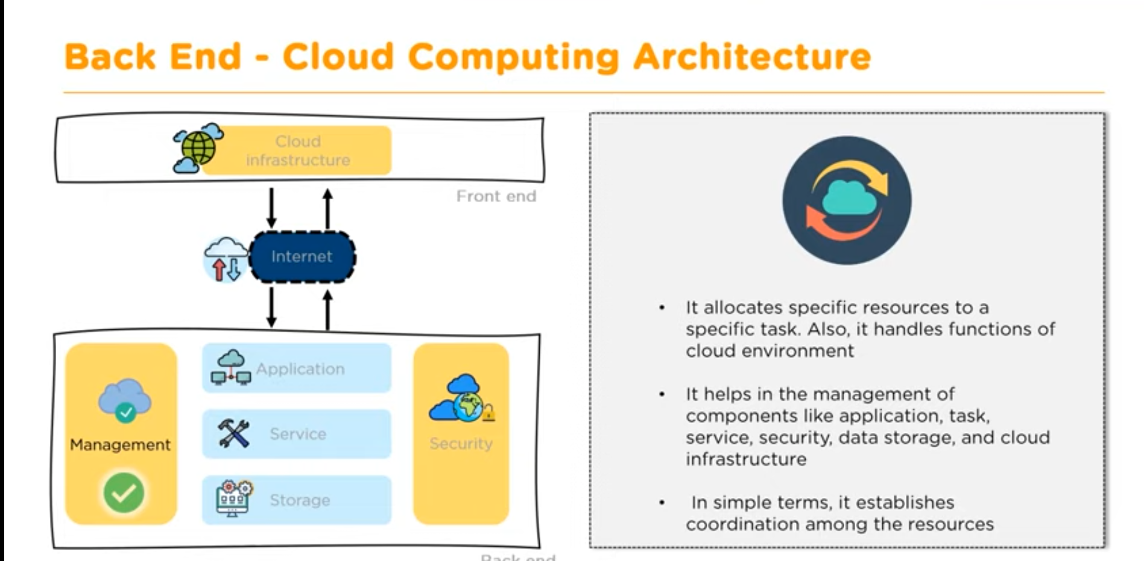

Slide 47
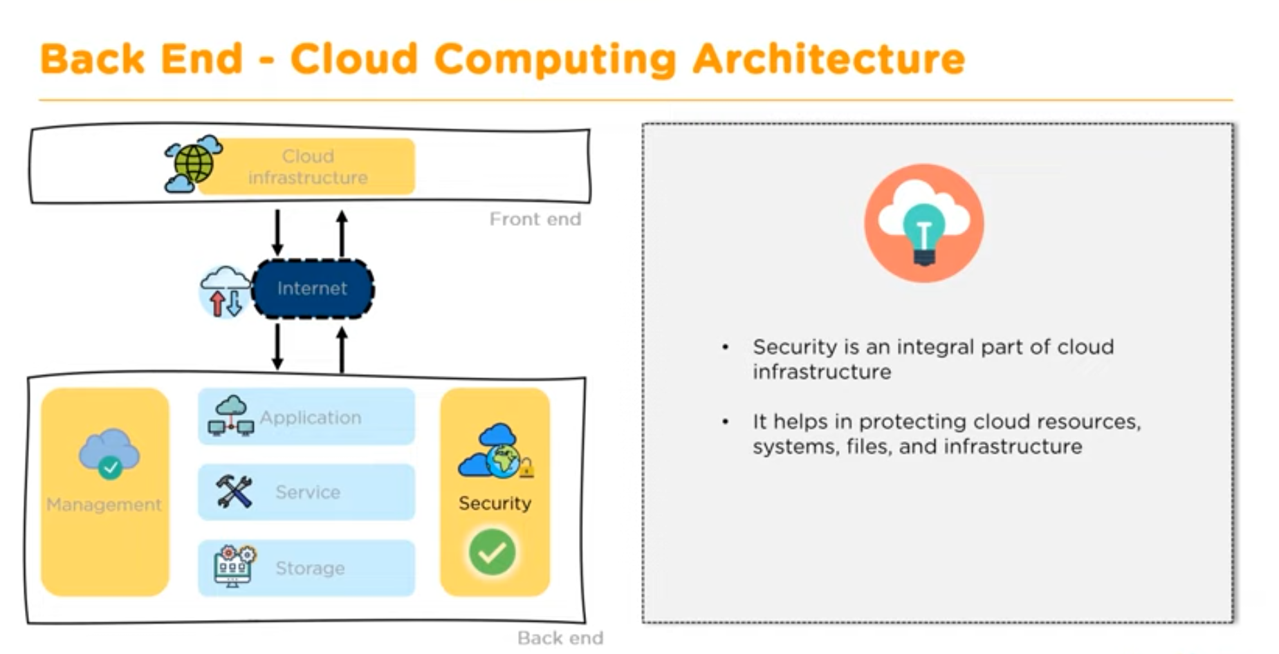

Slide 48
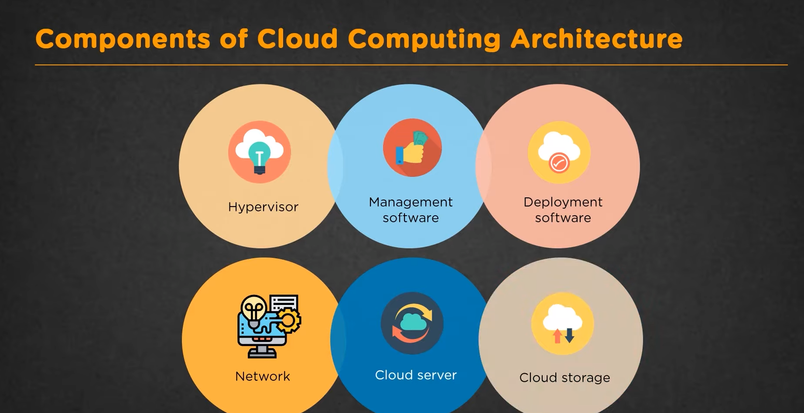

Slide 49
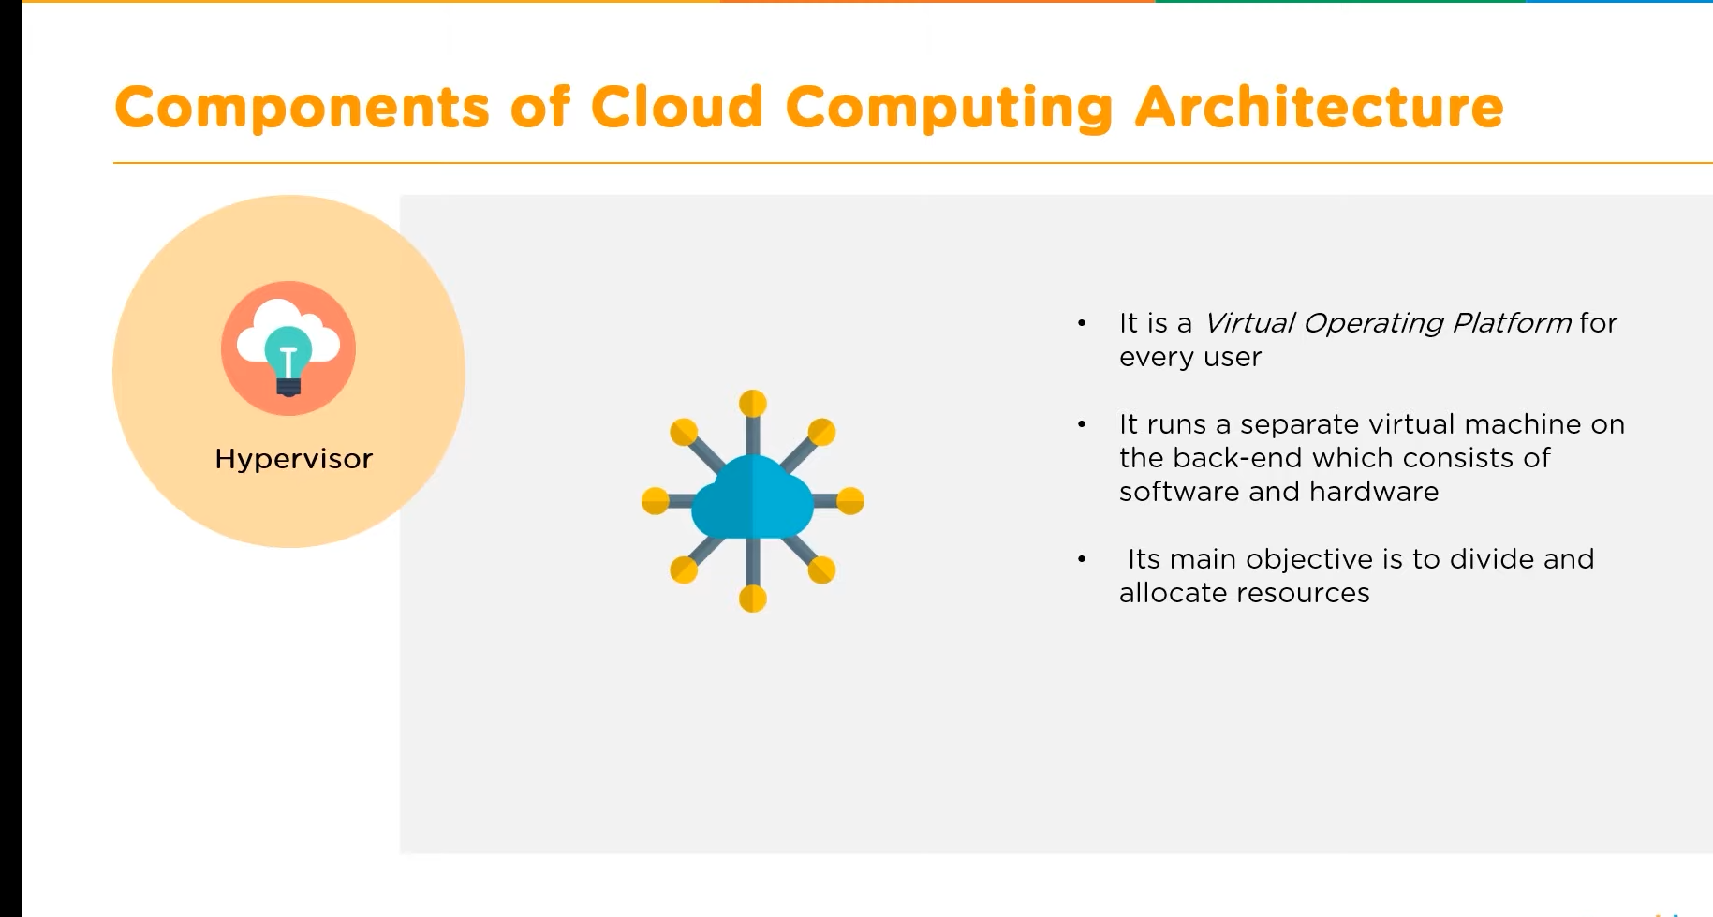

Slide 50
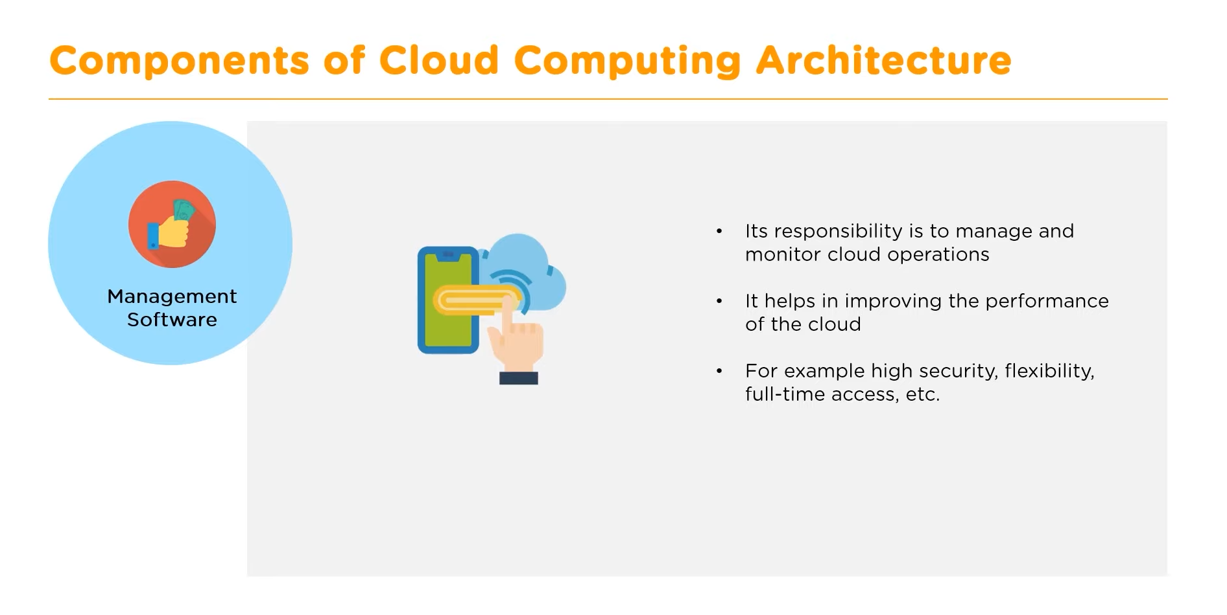

Slide 51
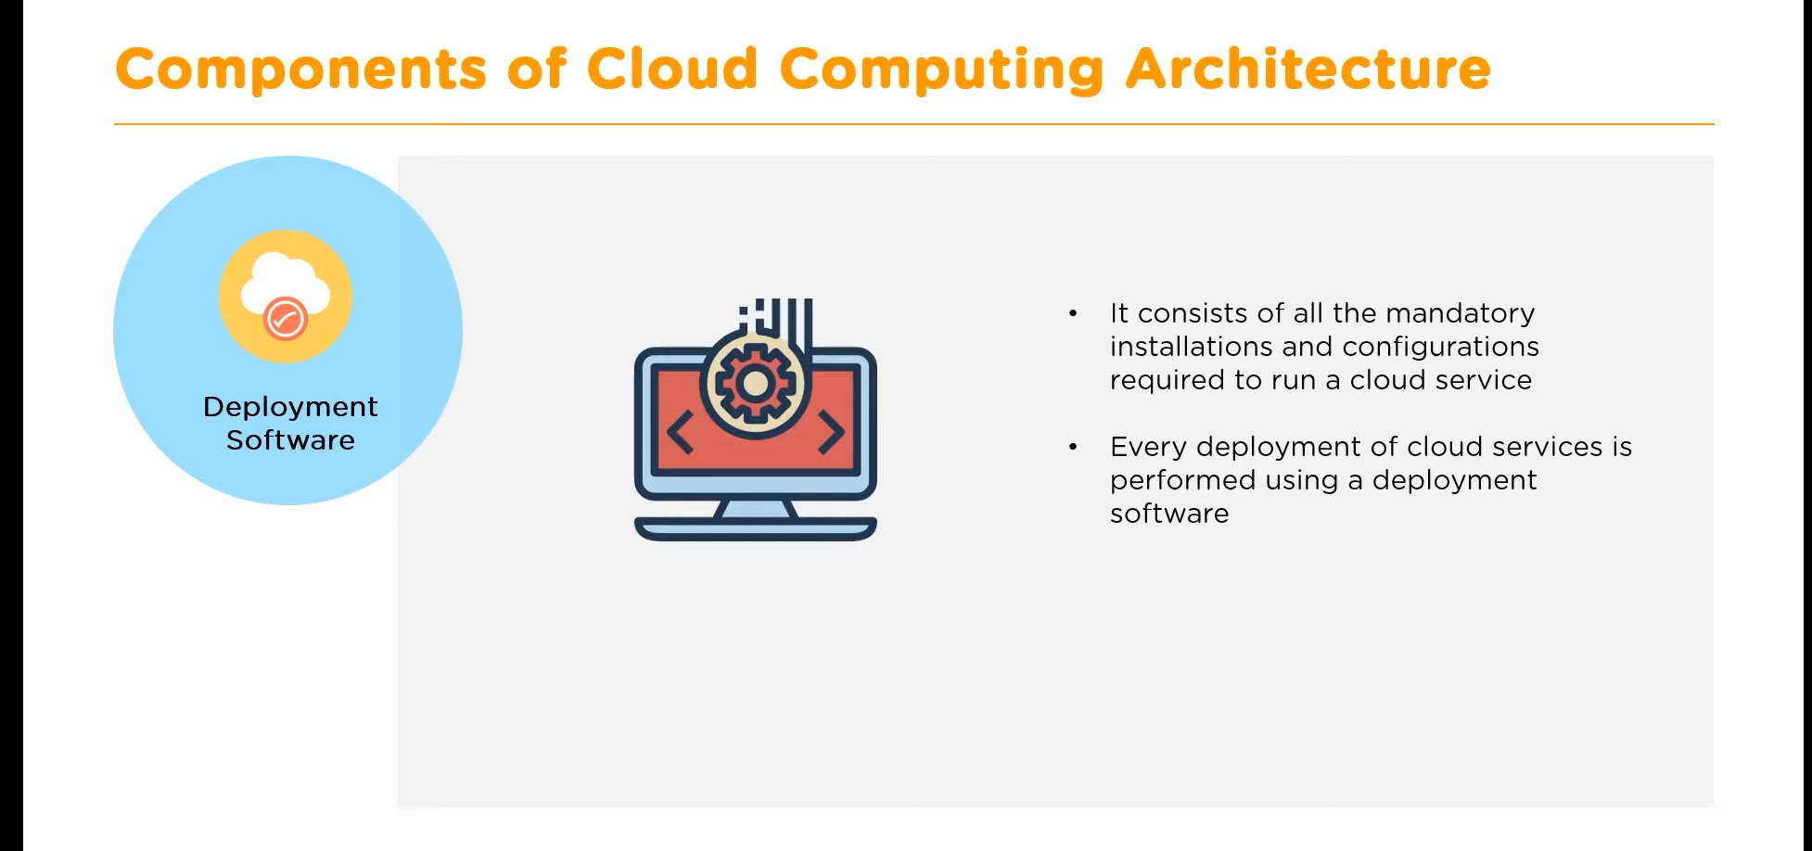

Slide 52
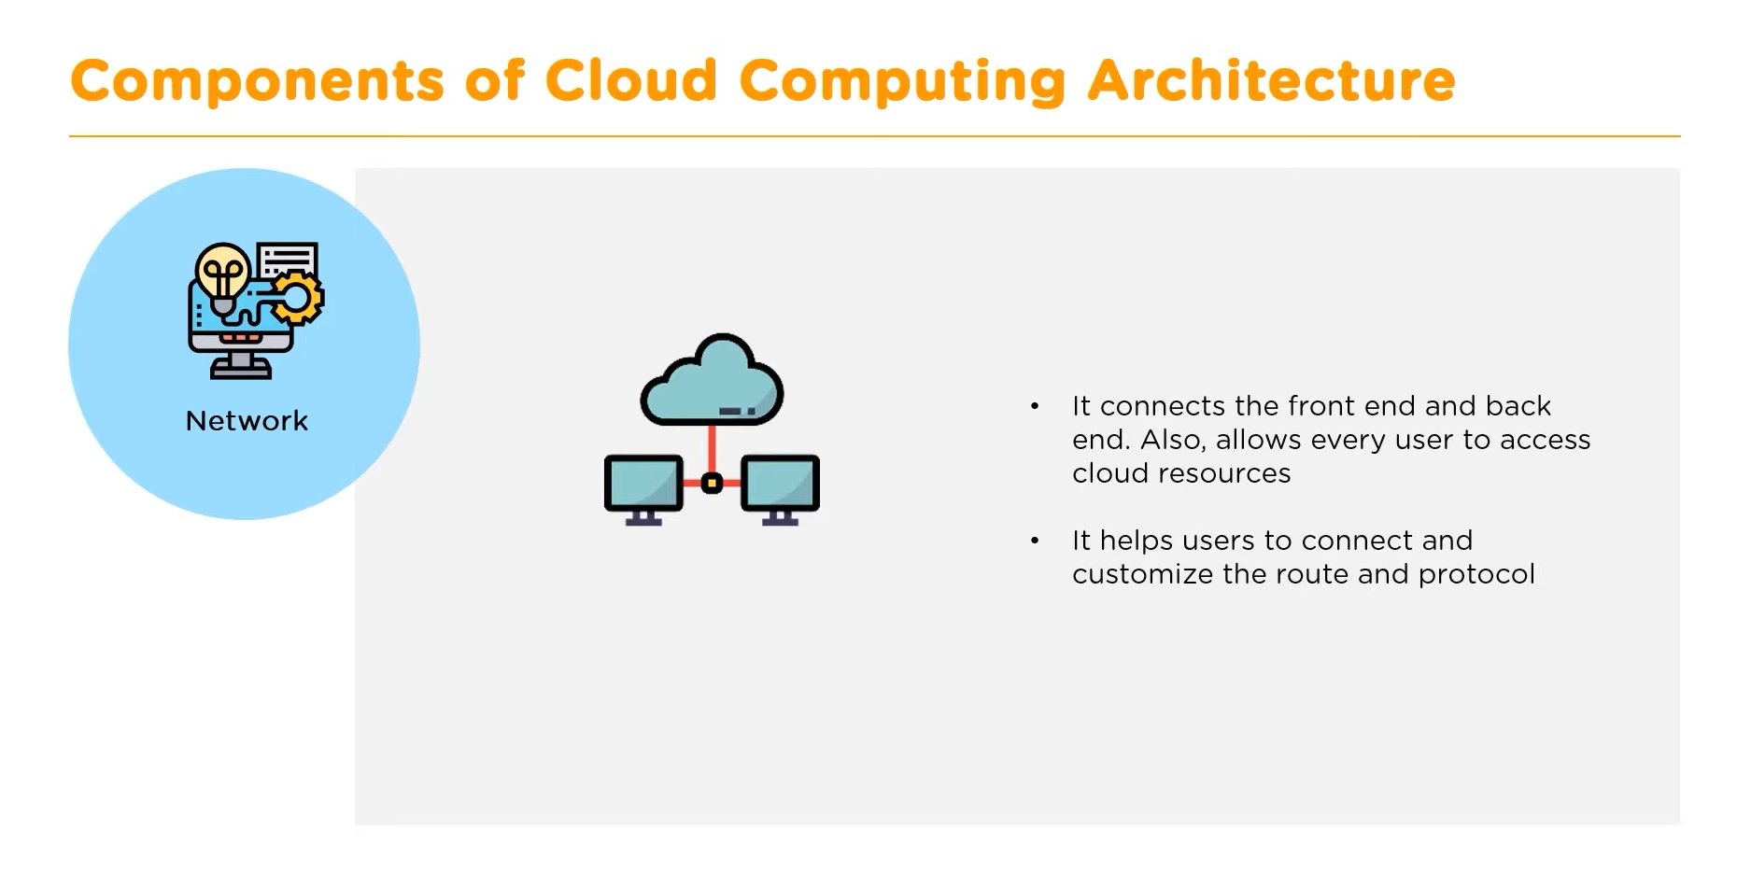

Slide 53
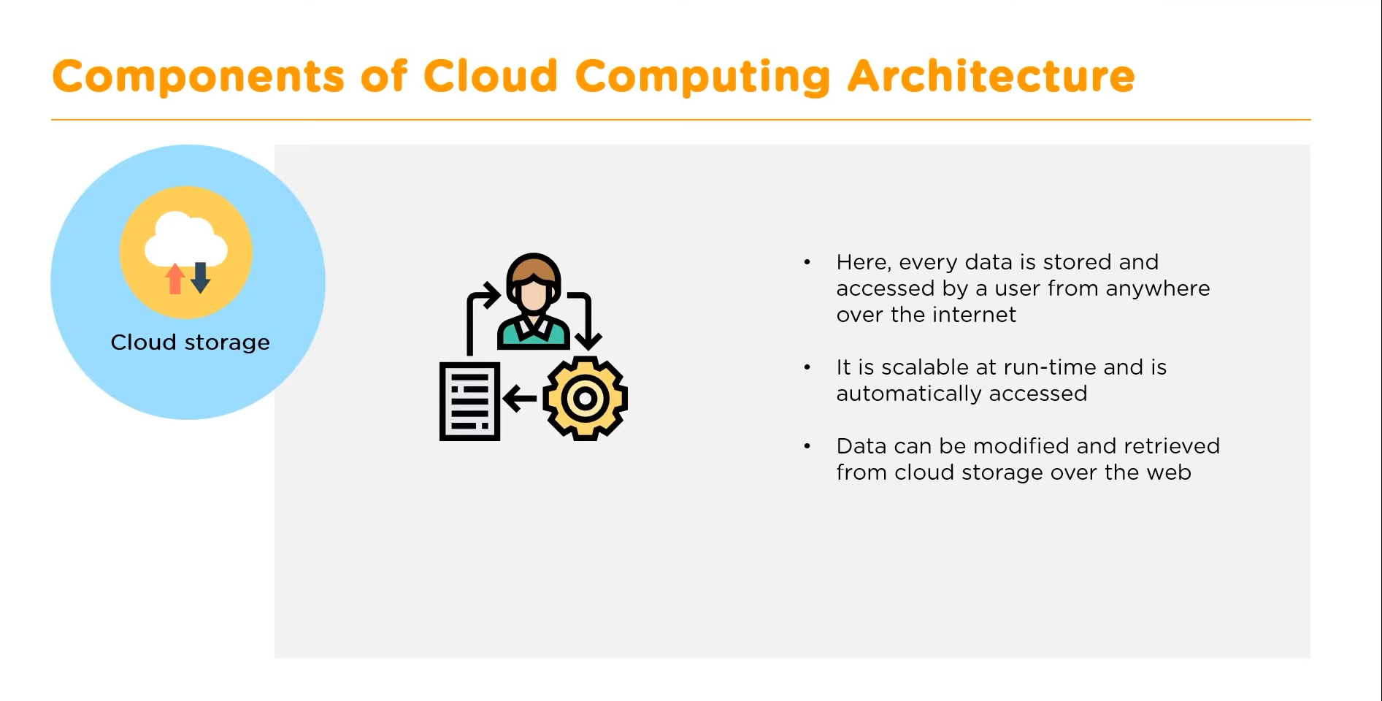

Slide 54
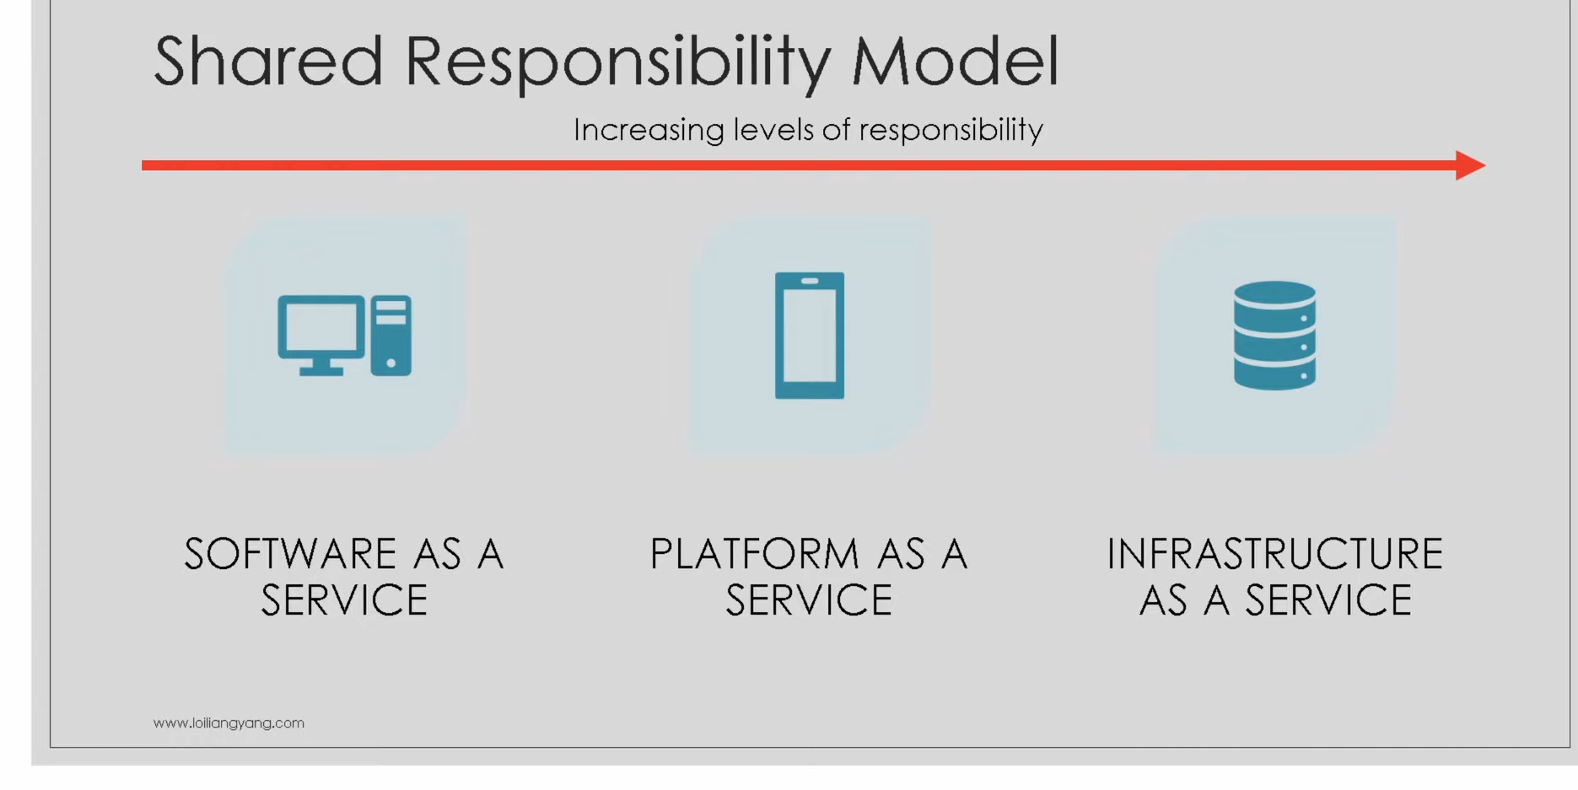

Slide 55
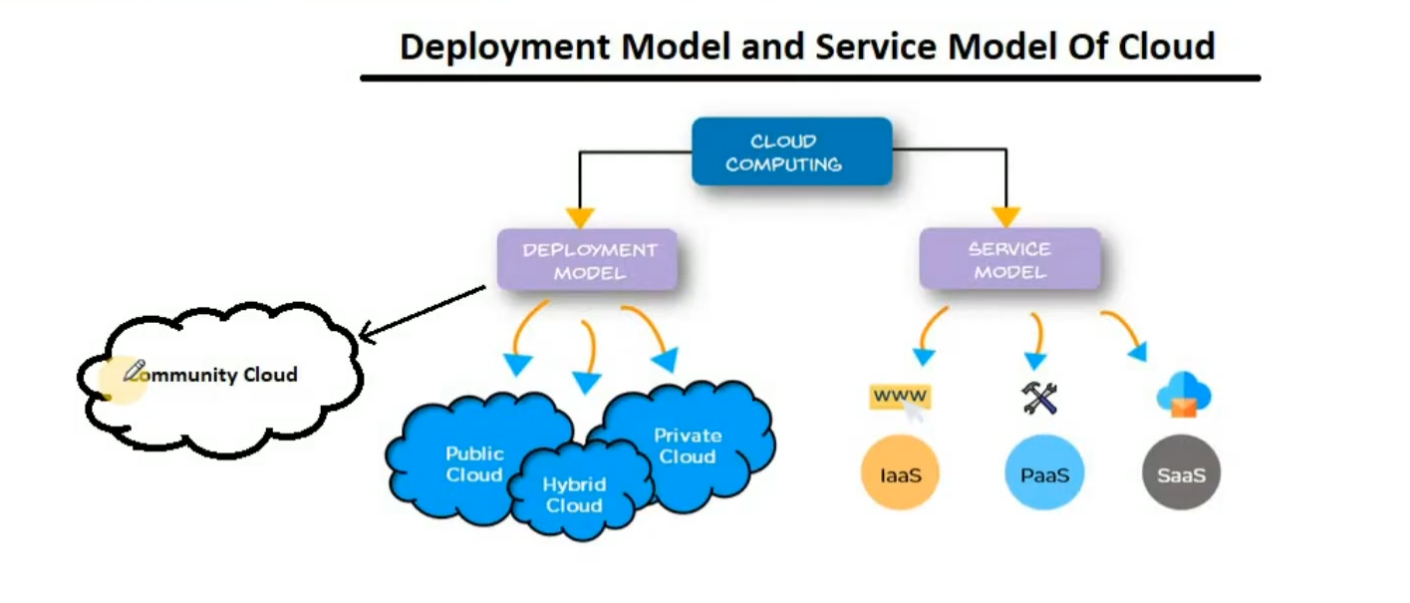

Slide 56
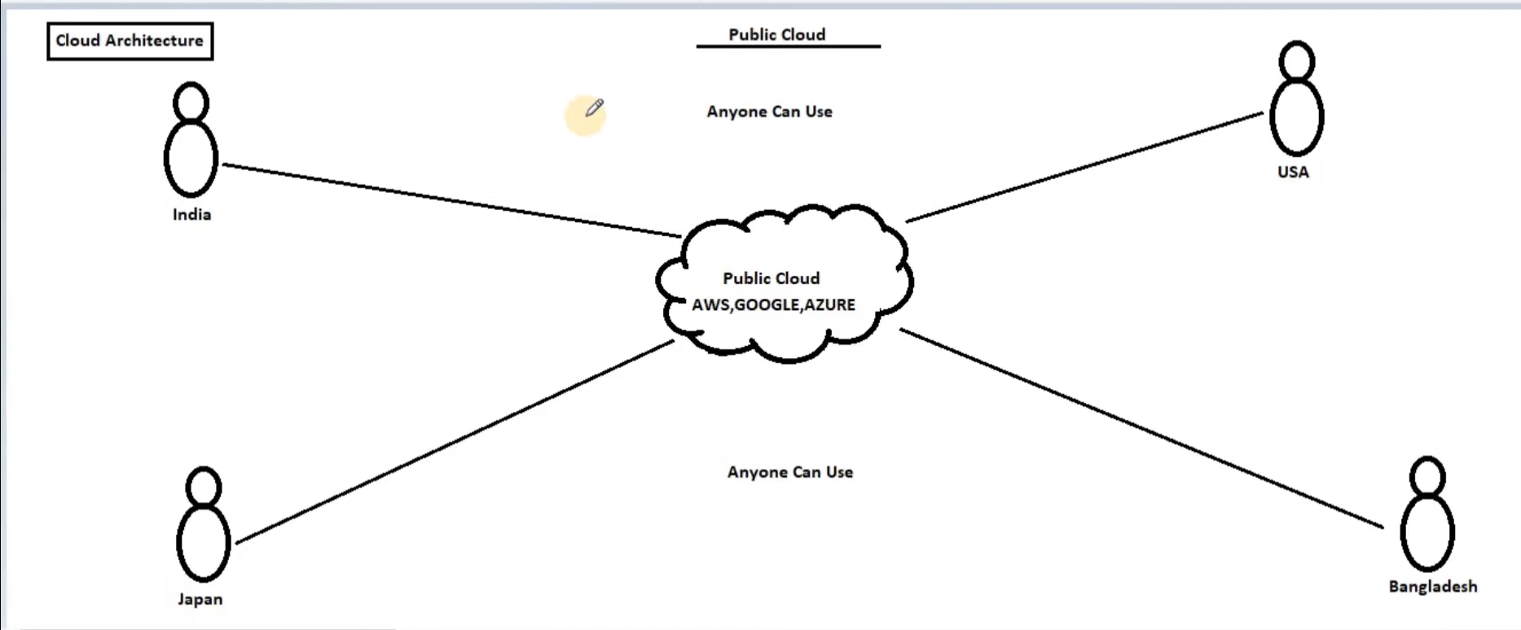

Slide 57
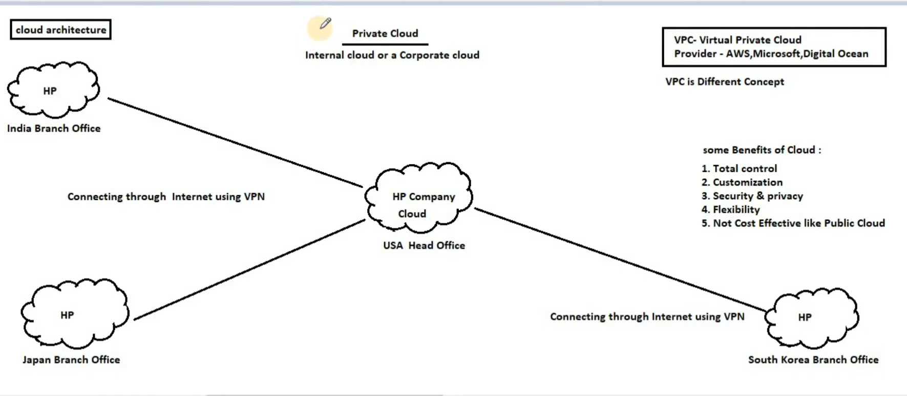

Slide 58
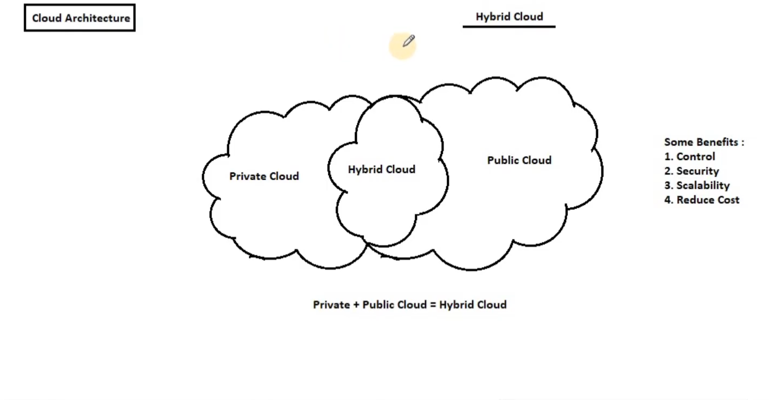

Slide 59
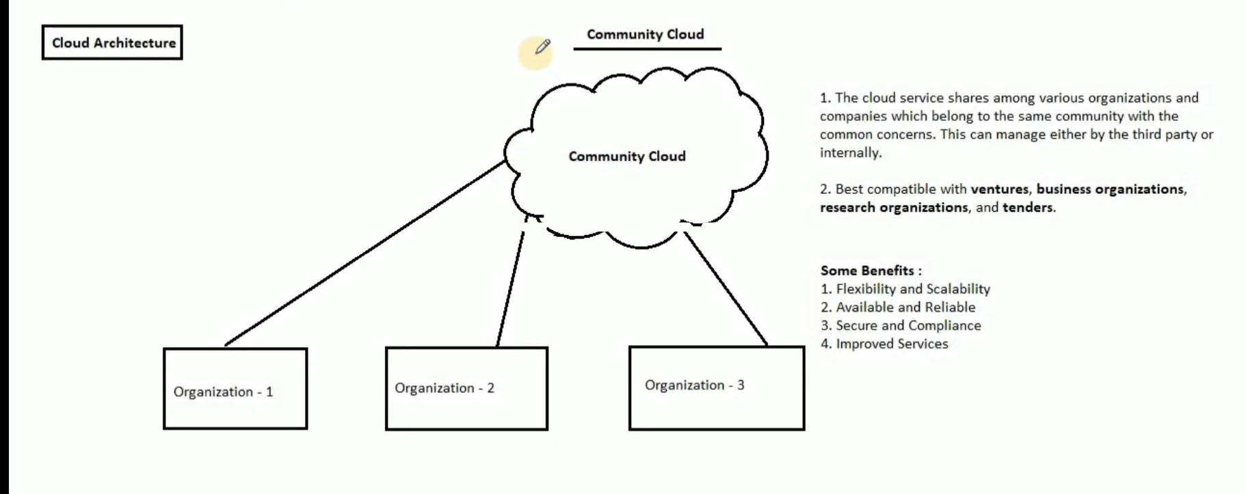

Slide 60
Security concern
1) Third party handling data
2) cyber attacks
3) Insiders threat
4)Govt intnision
5)Legal liability
6)Lack of support
7) Lack of standardization

Slide 61
Treats
1)DOS:Denial of service
2)MIM:Man in the middle
3)NS: Network sniffing
4)PS:Port Scanning
5)SIA:SQL injection attack
6)XSS: Cross site scripting attack

Slide 62
THANK YOU

